Slide 1
Project 3
Database Design and
Decisions
Michael Chang, Carlos Salinas, Akashdeep Singh, Bing Gao, Diyor Zoirov, Edwin Ramos, Jay Mistry

Slide 2

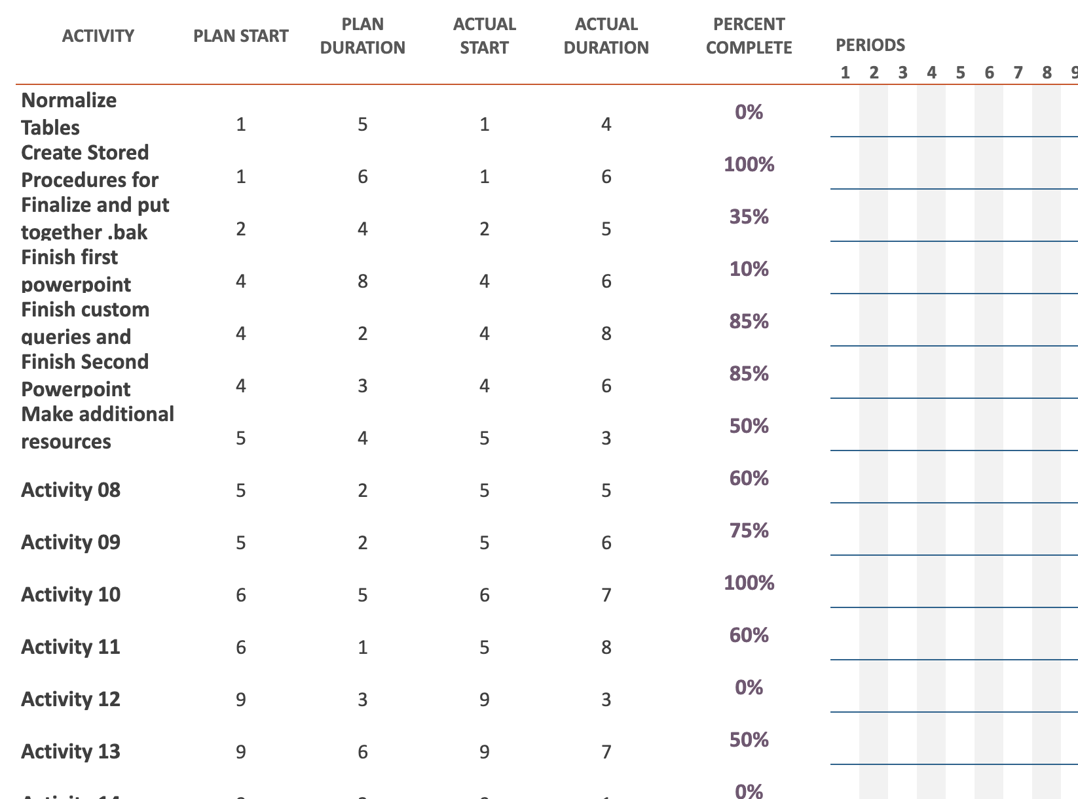
Gantt Planner

Slide 3
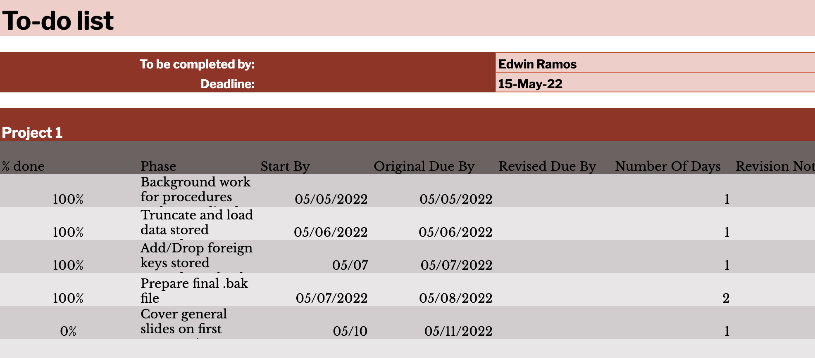
Individual To-do

Slide 4

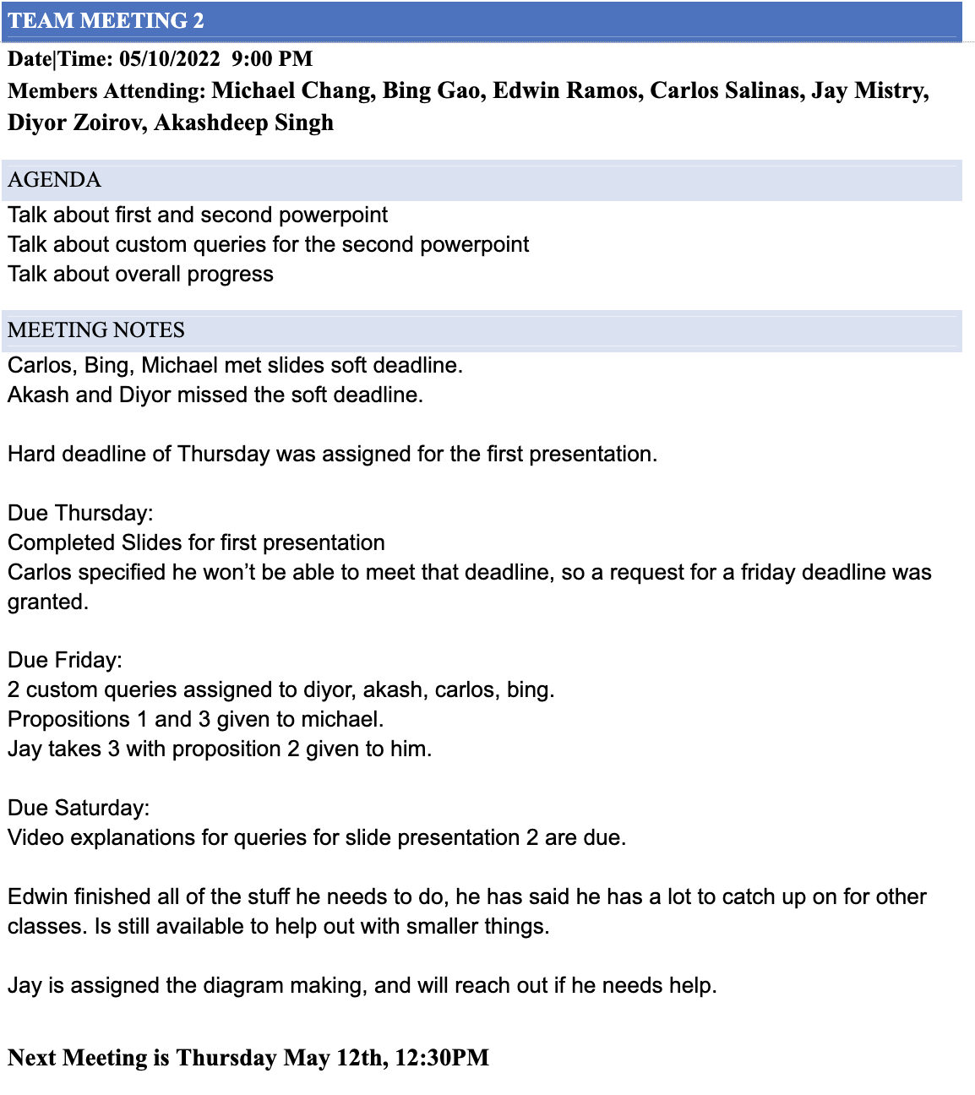
Meetings, assignments and deadlines

Slide 5
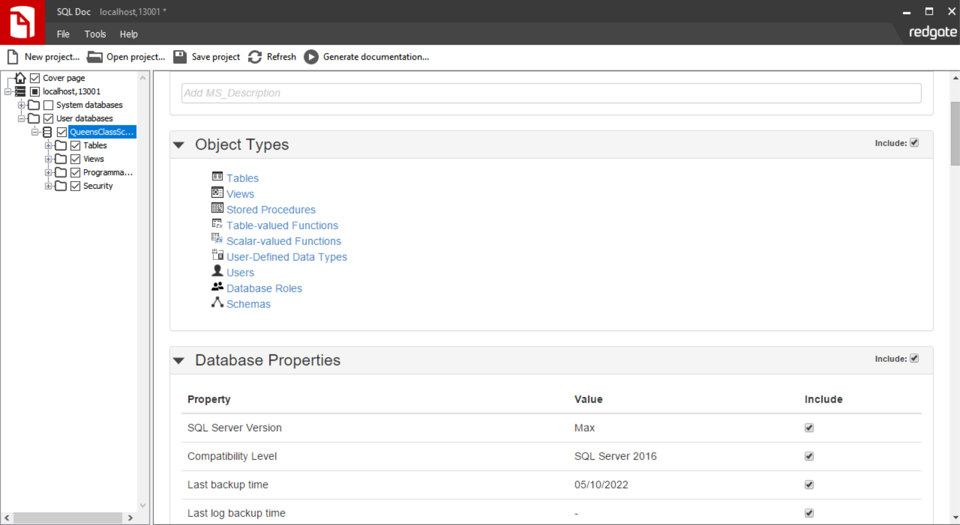
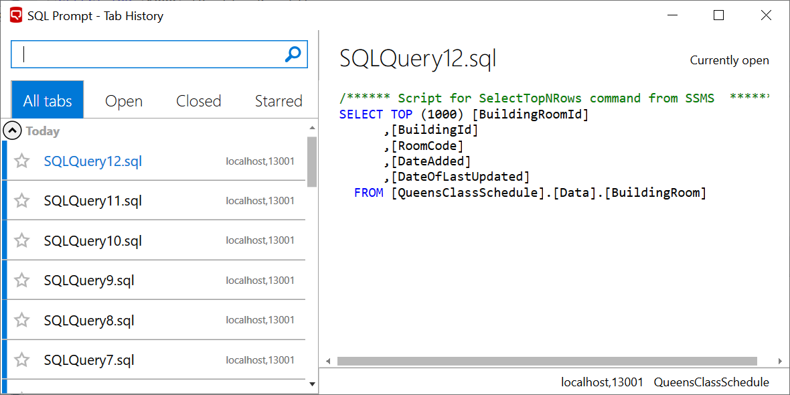
Redgate Toolbelt
Because of the framework of the project, Redgate tool usage was less than previous projects.
The two tools of major use were SQL Doc and SQL Prompt
The SQL Doc program compiles all the properties, settings and options of a database, its tables, and programmables etc. into documentation whose format is much easier to read and share with those who may not have the more specialized programs such as SSMS or knowledge to read raw script code.
The SQL Prompt program is more multifaceted with several useful features.
Specifically, Tab History allowed for faster navigation and even retrieval of “lost” tabs Additionally SQL Prompt provides a significant enhancement to Intellisense improving the quality of life while coding and creating queries. for the project

Slide 6
Carlos - Instructor Table

Slide 7
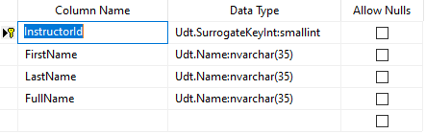
UDT’s
Udt.SurrogateKeyInt: smallint
Udt.Name: nvarchar(35)
Udt.Name: nvarchar(35)
Udt.Name: nvarchar(35)

Slide 8
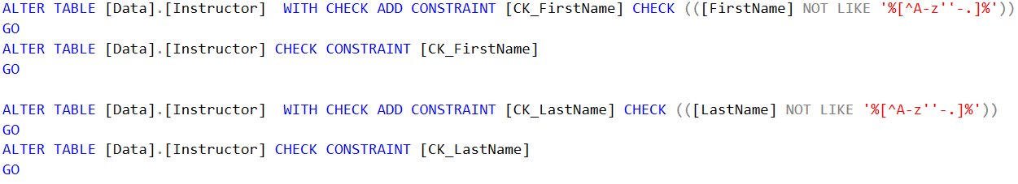
Constraints
Primary Key
Check FirstName
Check LastName
Check FullName

Slide 9
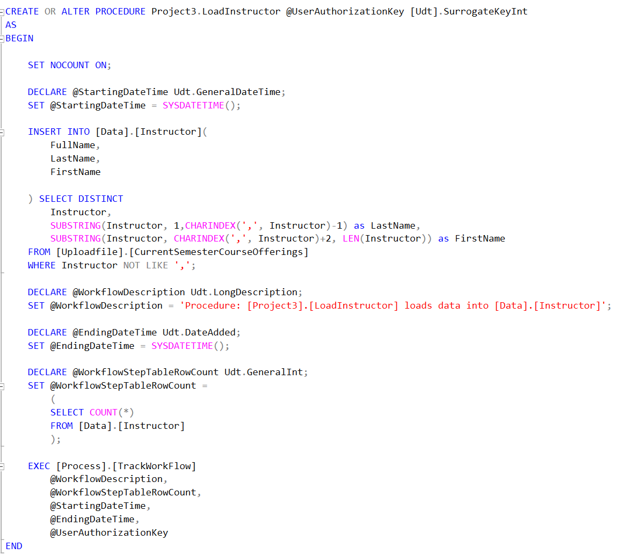
Stored Procedure
Procedures:
LoadInstructor

Slide 10
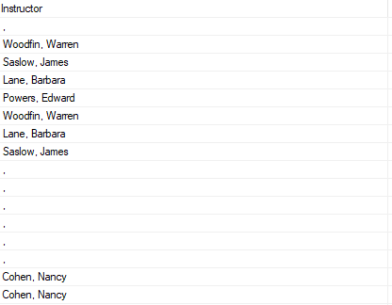
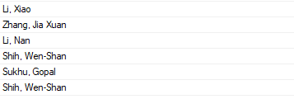

Data Cleansing
Empty Values as “ , “
LastName, FirstName
Middle Names
Other Characters

Slide 11
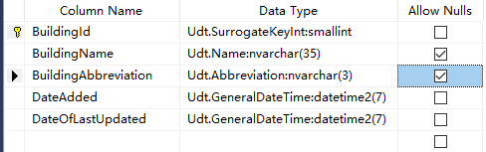
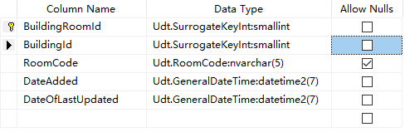
Bing - Building and Building Room Table
UDT’s
UDT:
Udt.SurrogateKeyInt:smallint for primary key and foreign key
Udt.Name:nvarchar(35)
Udt.Abbreviation:nvarchar(3)
Udt.RoomCode:nvarchar(5)
Udt.GeneralDateTime:datetime2(7)

Slide 12
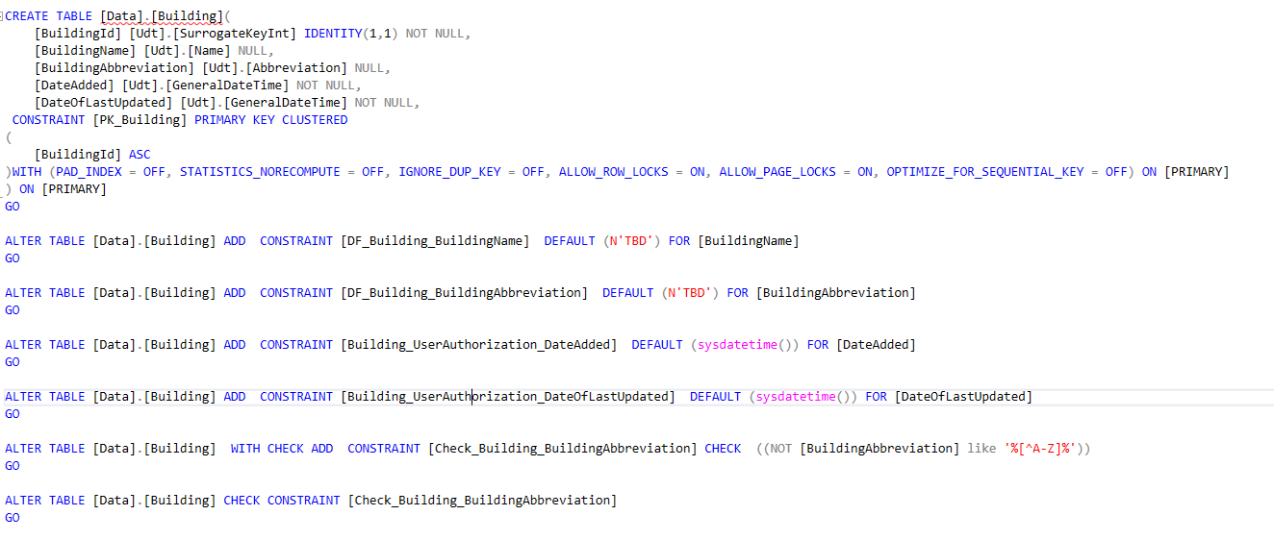
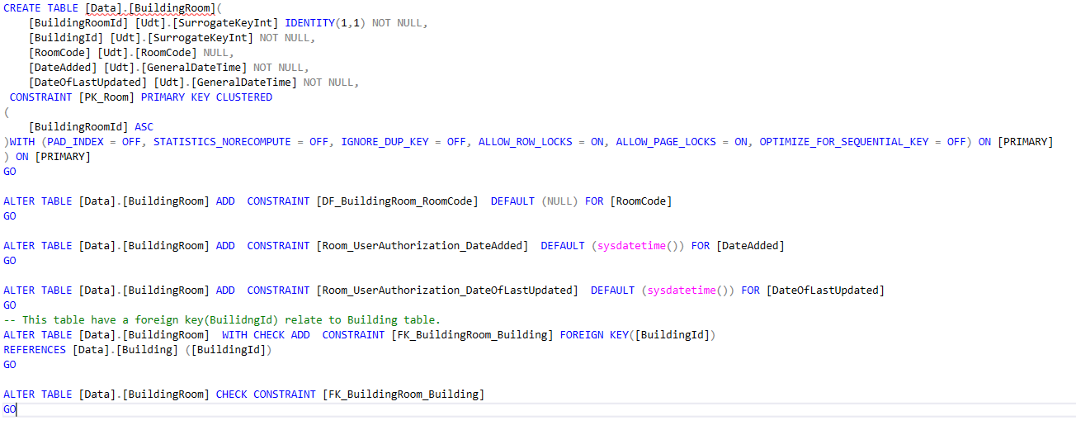
Constraints
Constraints:
Identity Constraint for Primary key and Foreign key
Not Null or Allow Null
Default value
Check Constraint

Slide 13
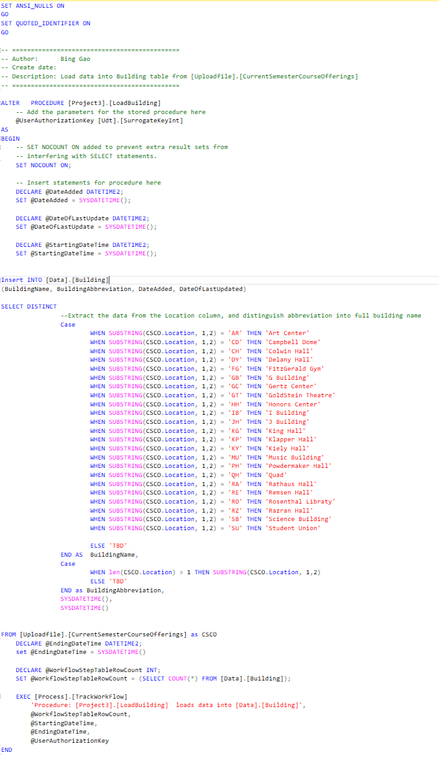
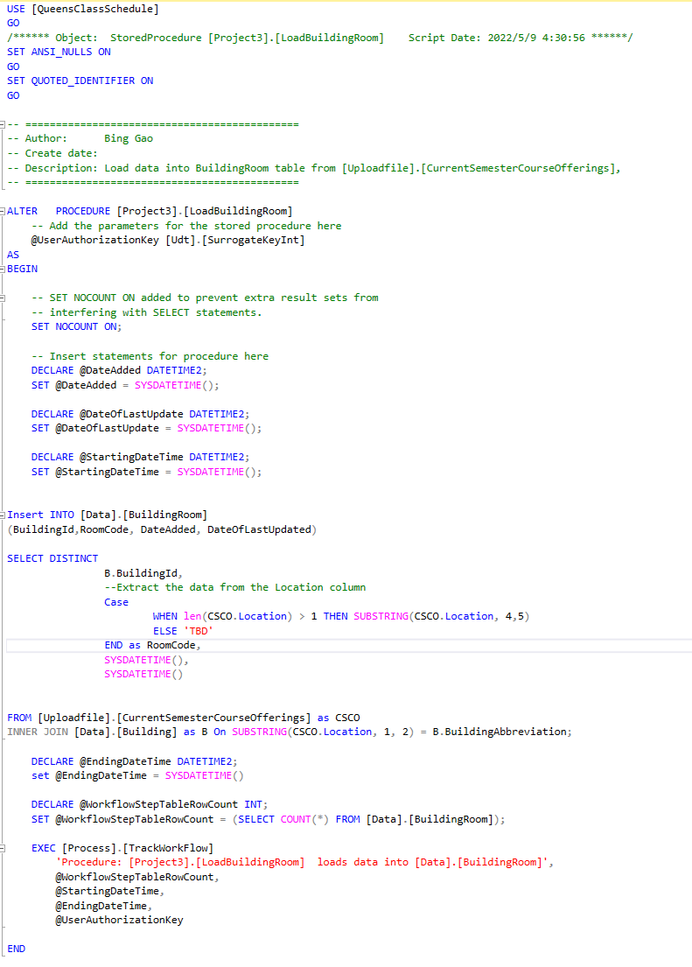
Stored Procedures
Procedures:
LoadBuilding
LoadBuildingRoom

Slide 14
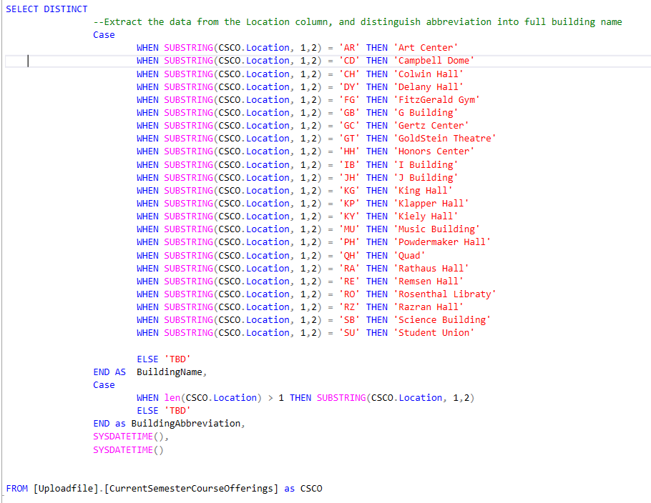
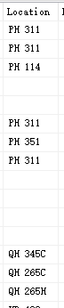
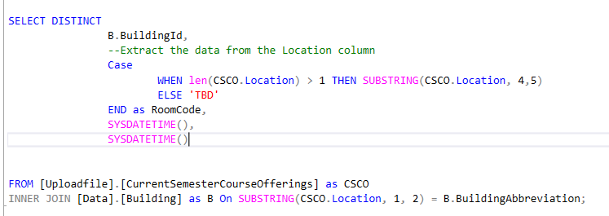
Data Cleansing
Data Cleansing:
Empty data in location column
Blank between Location data
Use Case statement and SUBSTRING function to deal with the data

Slide 15
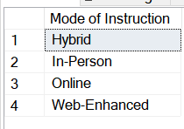
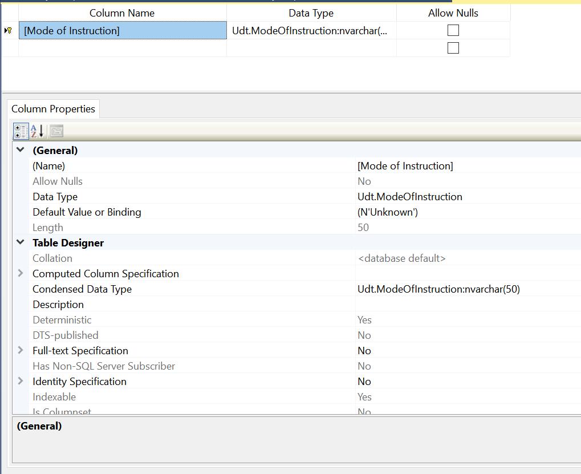
Mode of Instruction
Mode of Instruction is a very simple and self documenting one column table containing the methods through which classes at QC can be taught.
Because of said nature, the column [Mode of Instruction] is assigned to be the Primary Key of the table and intrinsically possesses the nonNullable and unique constraints. The default value is string ‘Unknown’
The UDT is a custom type of nvchar(50), but could have utilized any other UDTs with similarly appropriate length.
There were design discussions on whether to give it a surrogate key, but it was decided that the contextual benefits of a natural key outweighed possible scalability.

Slide 16
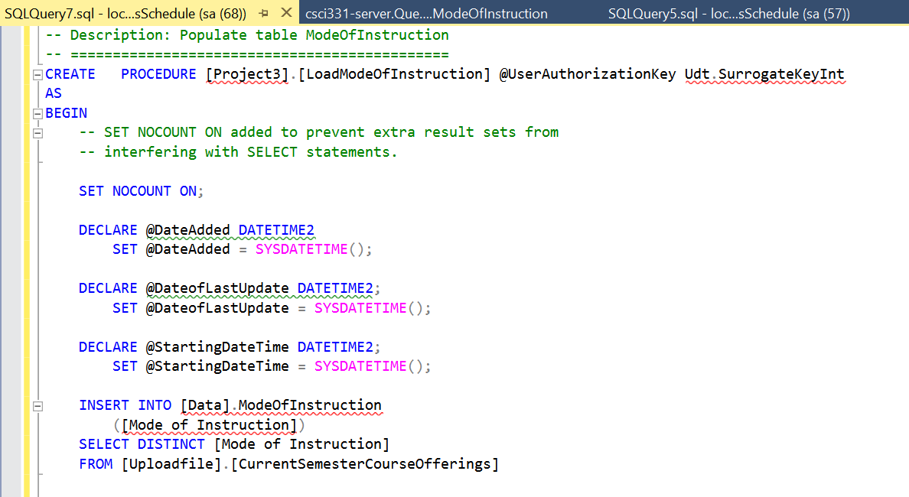
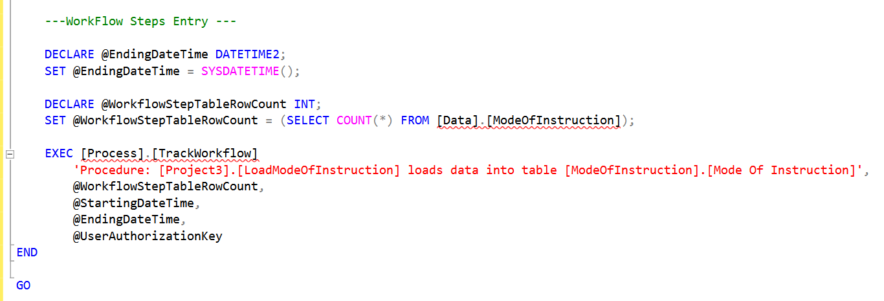
Stored Procedure
This procedure has two processes, while taking a surrogate int identity key as a parameter.
The first one is to populate the table [Data].ModeofInstruction’s single column [Mode of Instruction] with the distinct values found within table [Uploadfile].[CurrentSemesterCourseOfferings]
The second process is to generate various time stamps and row changes caused by this procedure and log it in the table found in [Process].[TrackWorkflow]

Slide 17
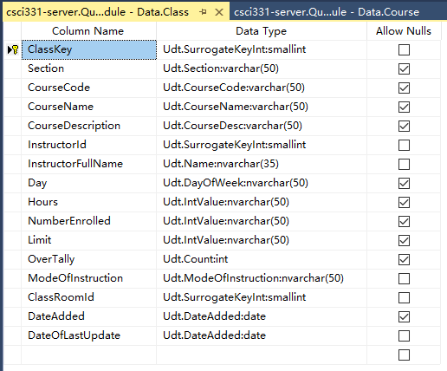
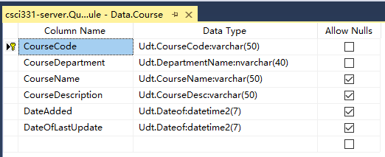
Akashdeep - Class and Course Table UDT’s

Slide 18
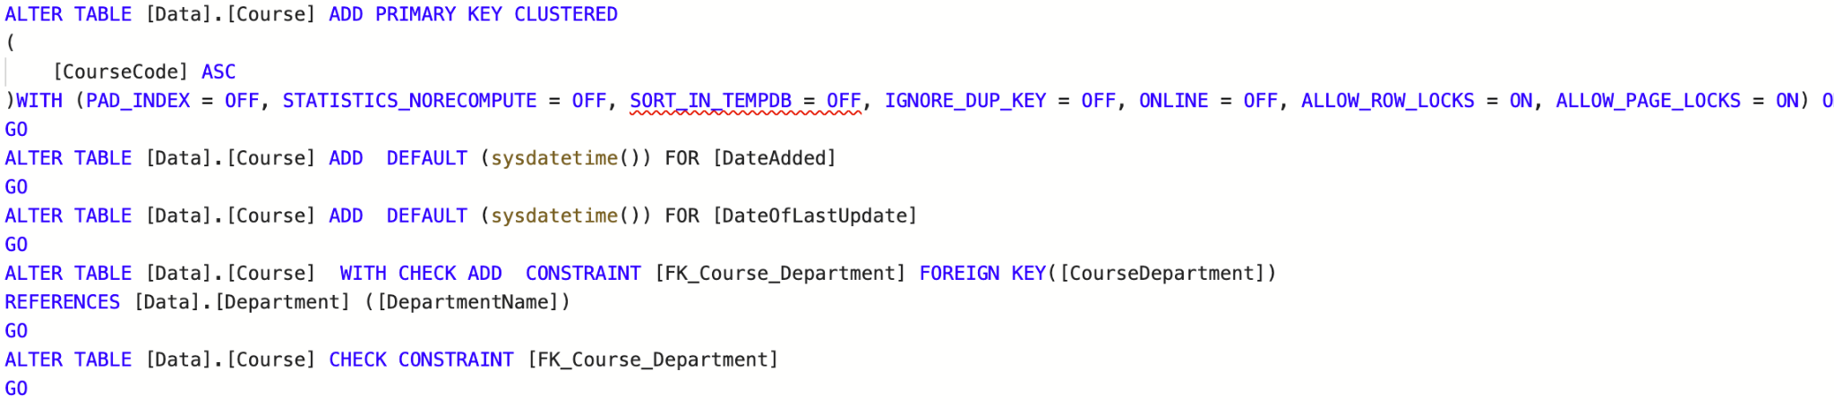
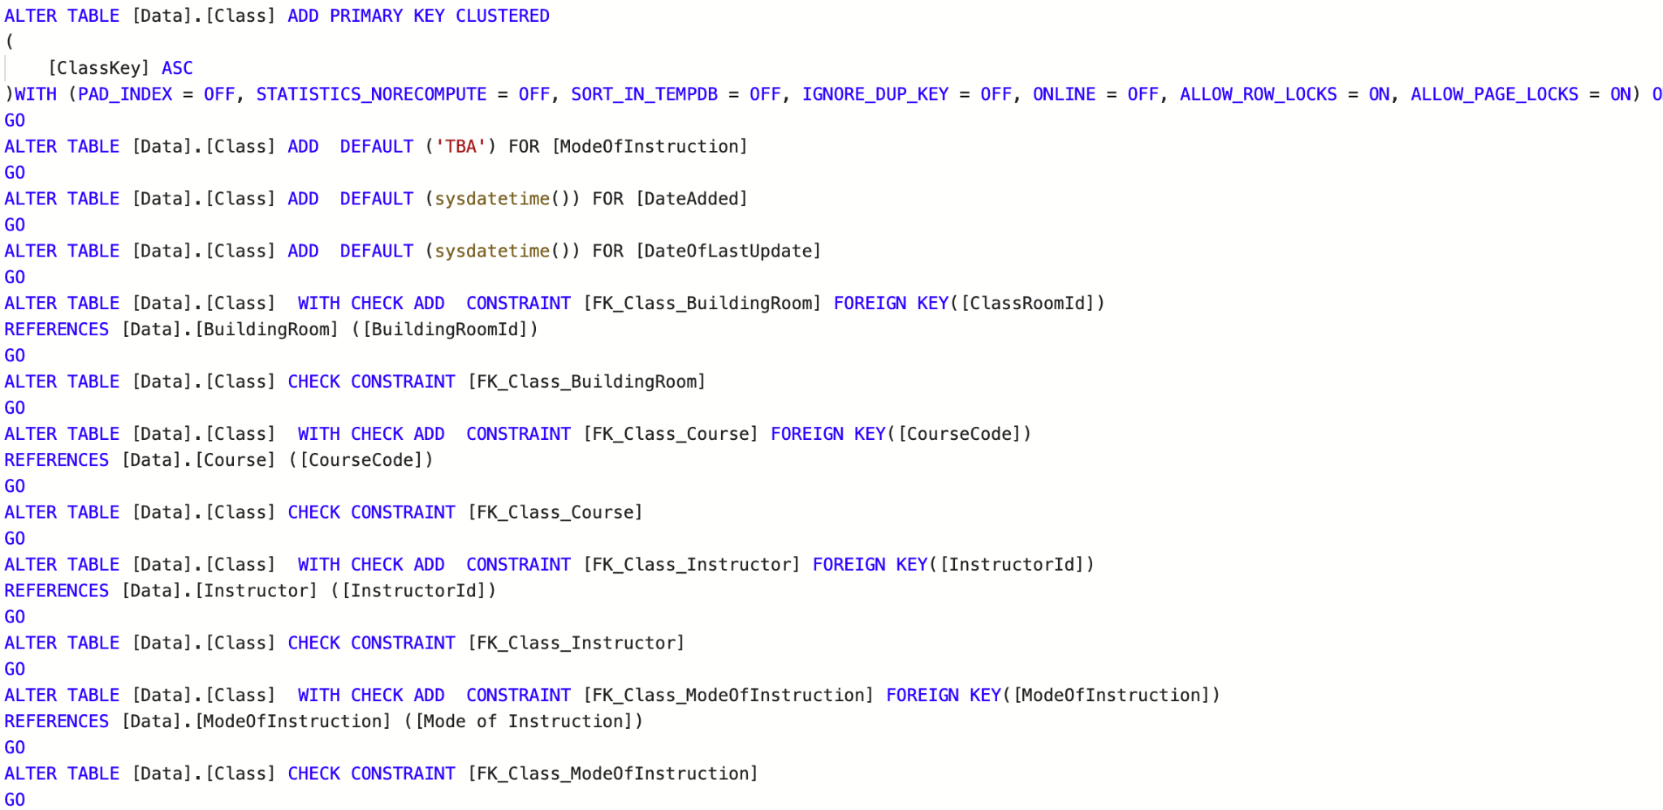
Constraints
Default Values for sysdatetime’s
Identity Constraints for PK’s and FK’s
Variability for Null/Not null
Check constraints

Slide 19
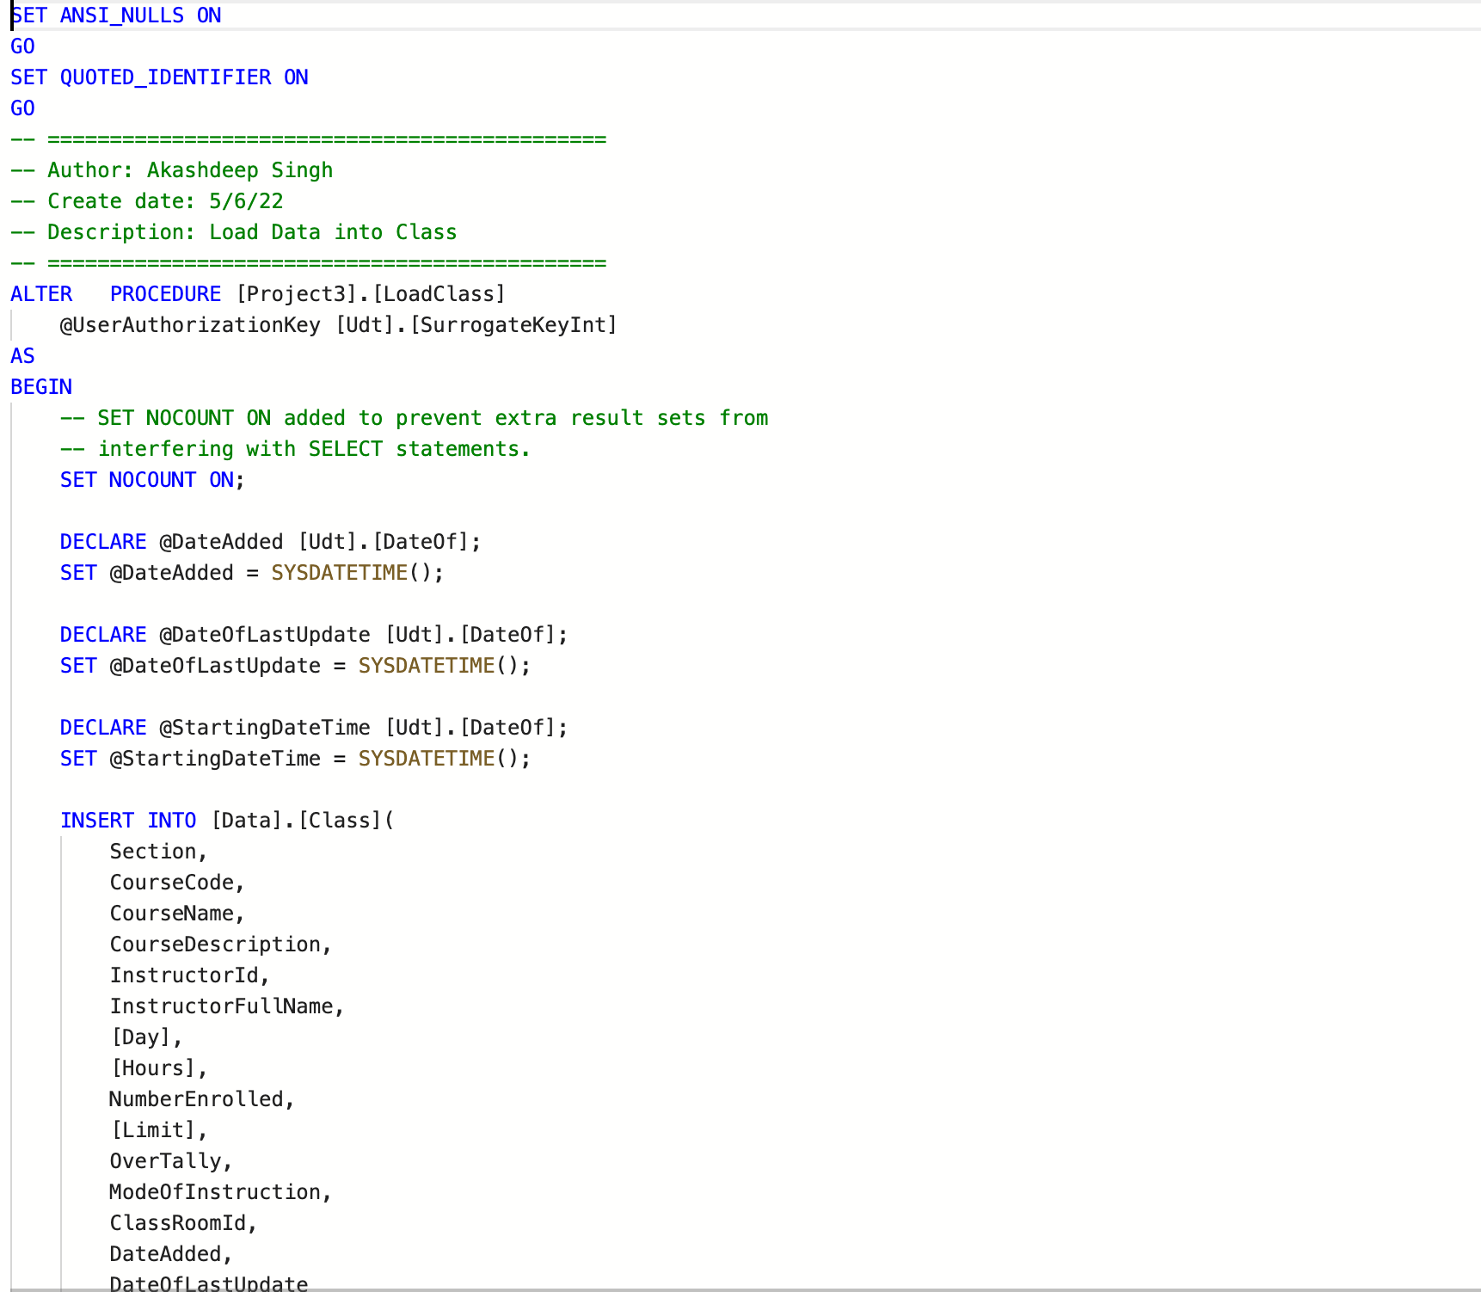
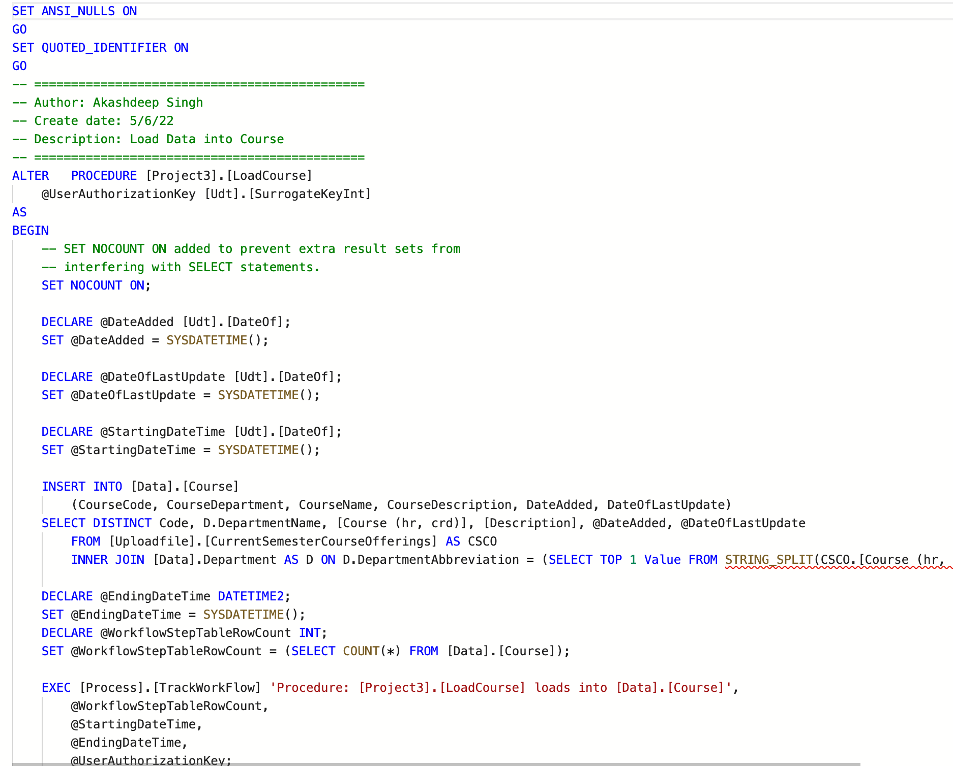
Stored Procedures
LoadClass
LoadCourse

Slide 20
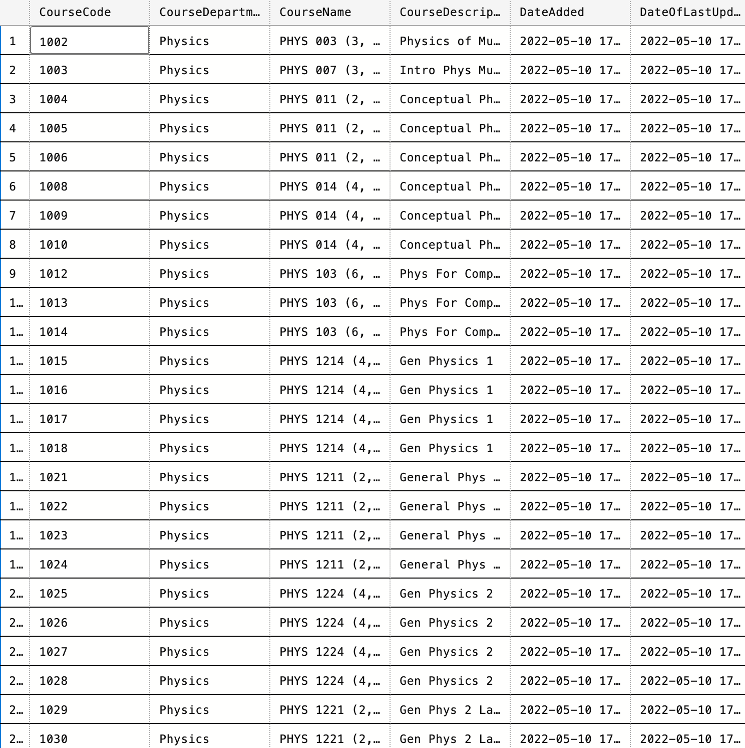
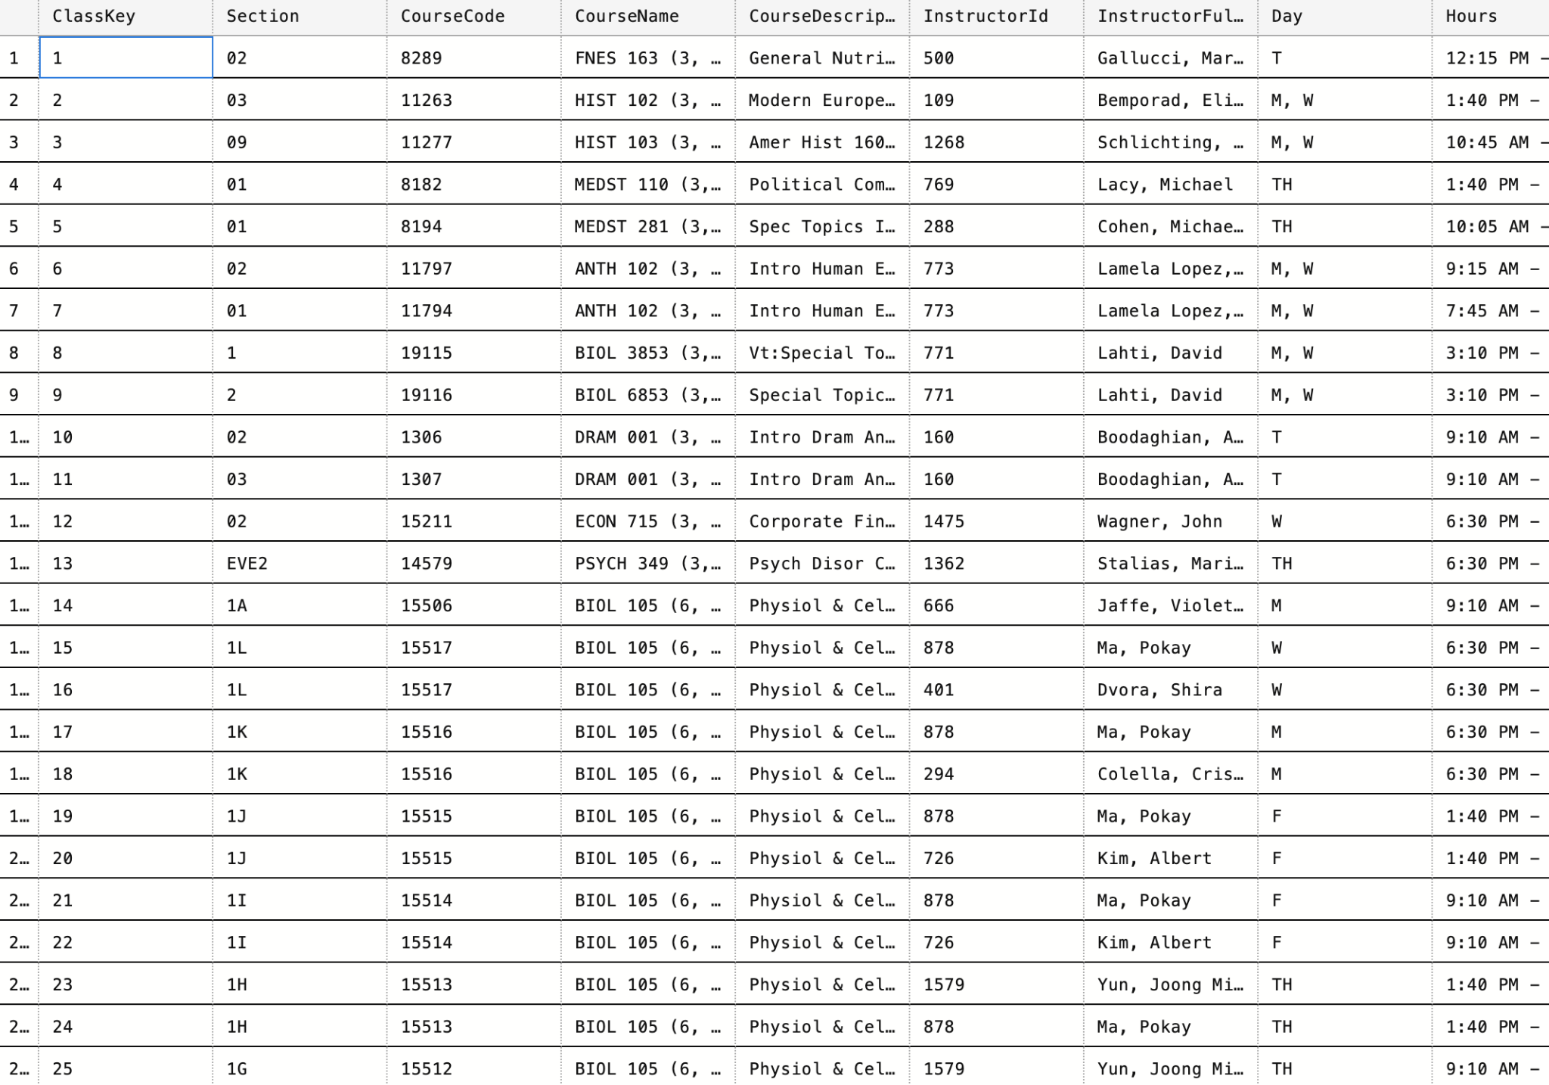
Data Cleansing
Empty Values as “ , “ in
columns for location, courses,
etc.
Other Characters
Course names

Slide 21
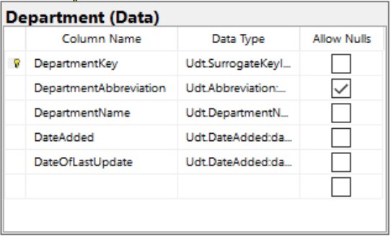
Diyor - Department Table UDT’s
UDT:
Udt.SurrogateKeyInt
Udt.Abbreviation
Udt. DepartmentName
Udt. DateAdded

Slide 22
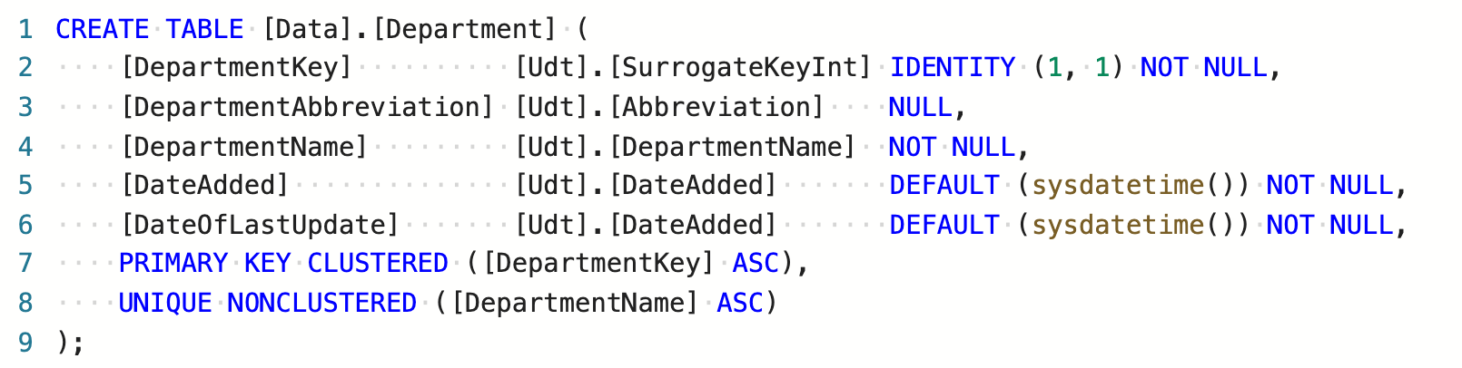
Constraints
Primary Key
Auto Incremental
Not Null
Default

Slide 23
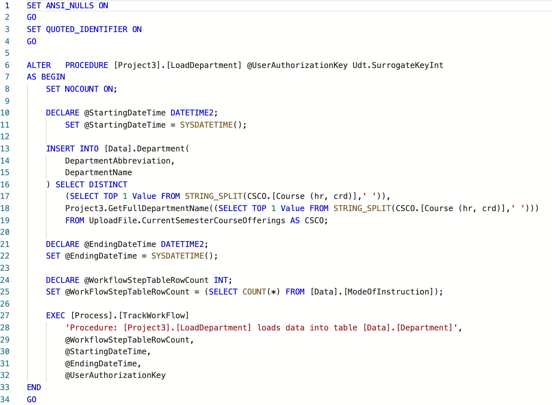
Stored Procedure
Procedures:
LoadDepartment

Slide 24
Data Cleansing
There was not much data to be cleansed since the table was simple
Slip function is used to slip string values
Department Names

Slide 25
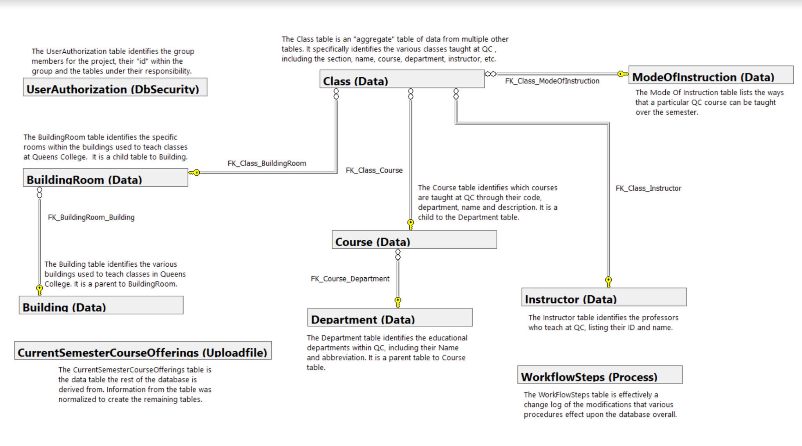
Conceptual Model Diagram

Slide 26
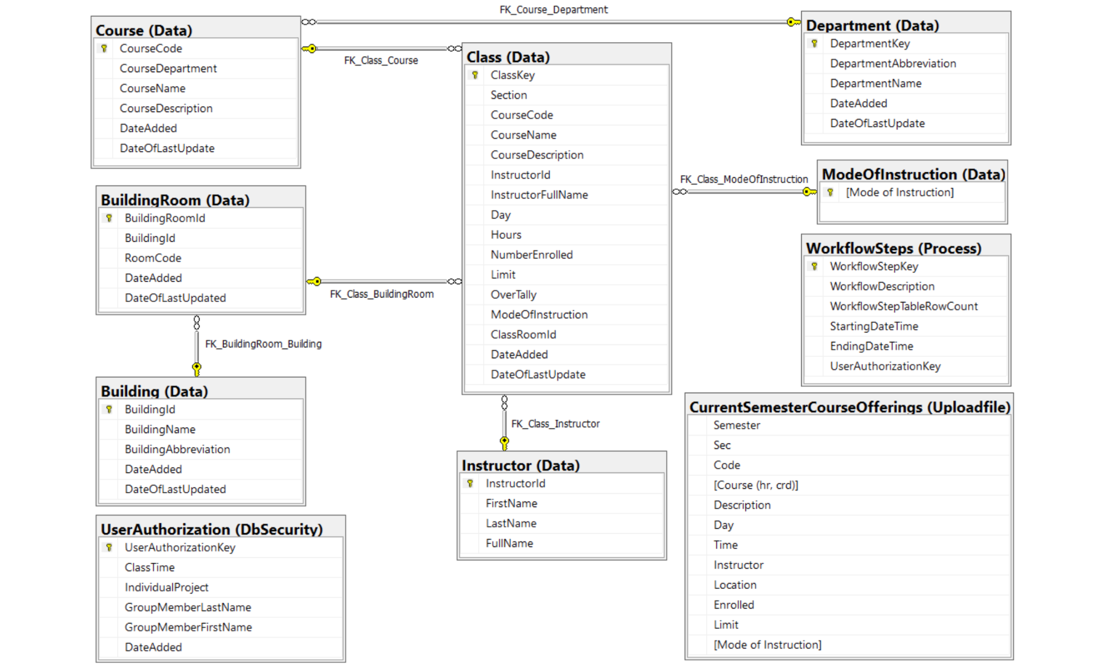
Logical Model Diagram

Slide 27
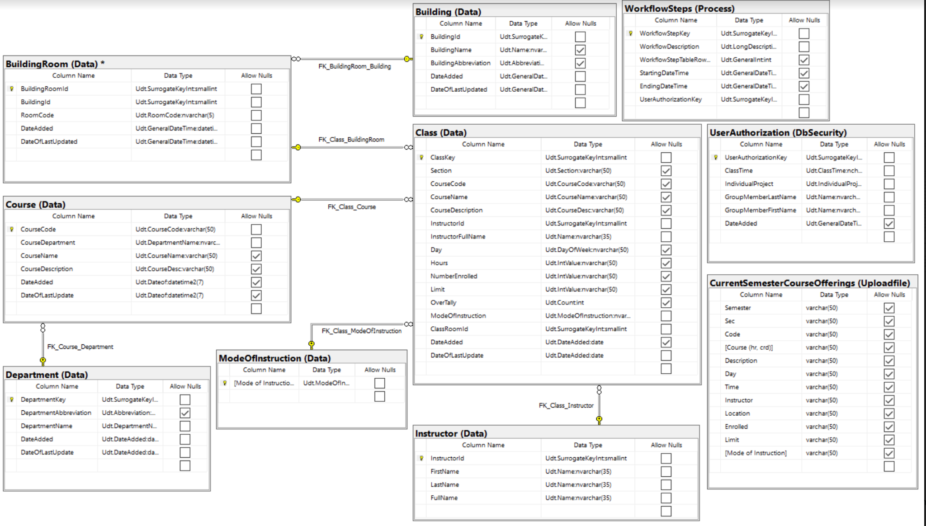
Physical Data Model Diagram

Slide 28
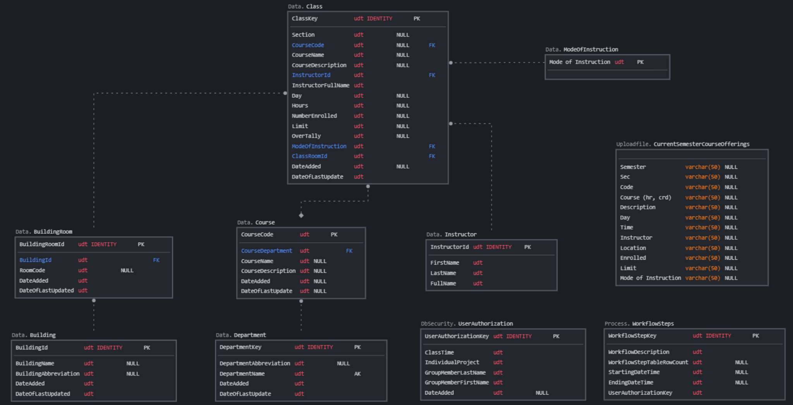
Entity Relationship Diagram

